Slide 1
Feature Selection
Process of selection a subset of relevant features for use in ML model
Simple models are easier to interpret
Shorter training times
Enhanced generalisation by reducing overfitting
Easier to implement by software developers
Reducing variable redundancy
Some models perform badly in high dimensional spaces (Tree based)

Slide 2
Procedure
A feature selection algorithm is
Combination of a search technique
Evaluation measure which scores the different feature subsets
Trying every subset of the features is computationally expensive
And different feature subsets may produce different performance for different ML algorithms

Slide 3
Methods
Filter Methods
Rely on the characteristics of the data (feature characteristics)
Do not use machine learning algorithms
Model agnostic
Tend to be less computationally expensive
Usually give lower prediction performance than a wrapper methods
Are very well suited for a quick screen and removal of irrelevant features
Wrapper Methods
Use predictive machine learning models to score the feature subset
Train a new model on each feature subset
Tend to be very computationally expensive
Usually provide the best performing feature subset for a given machine learning algorithm
They may not produce the best feature combination for a different machine learning model

Slide 4
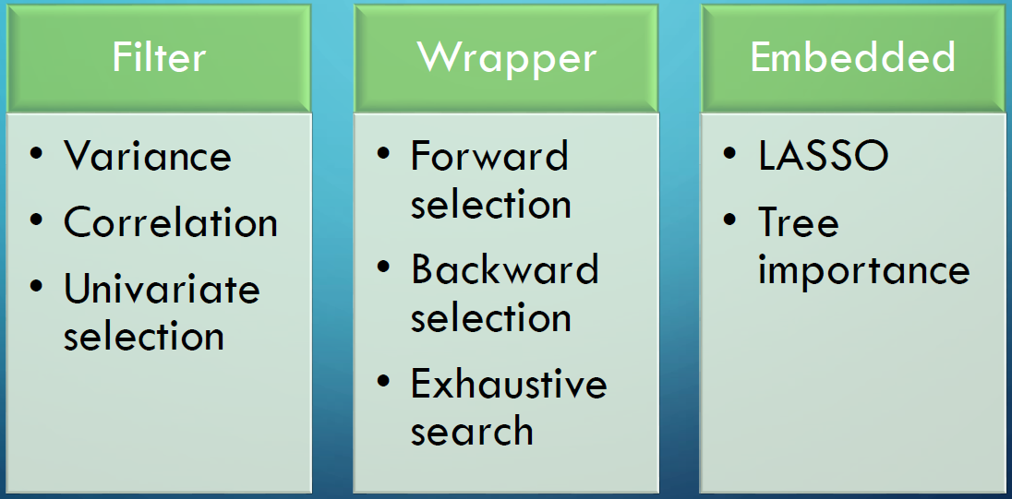
Methods
Embedded Methods
Perform feature selection as part of the model construction process
Consider the interaction between features and models
They are less computationally expensive than wrapper methods, because they fit the machine learning model only once.

Slide 5
Filter Methods - Univariate
Select variables independently of the machine learning algorithm
Rely only on the characteristics of the data (of the variables)
Model agnostic
Fast computation
Two step procedure:
Rank features according to a certain criteria
Each feature is ranked independently of the feature space
Select the highest ranking features
May select redundant variables because they do not consider the relationships between features

Slide 6
Filter Methods – Ranking Criteria
Feature scores on various statistical tests:
Chi-square | Fisher Score
Univariate parametric tests (anova)
Mutual information
Variance
Constant features
Quasi-constant features

Slide 7
Filter Methods - Multivariate
Handle redundant feature
Duplicated features
Correlated features
Filter Methods in general:
Simple yet powerful methods to quickly remove irrelevant and redundant features
First step in feature selection procedures

Slide 8
Wrapper Methods
Evaluate the features in the light of a specific machine learning algorithm
Evaluate subsets of variables
Detect interactions between variables
Find the optimal feature subset for the desired classifier

Slide 9
Wrapper Methods – Procedure
Search for a subset of features
Build a machine learning model on the selected feature subset
Evaluate model performance
Repeat
How to search for the subset of features?
How to stop the search?

Slide 10
Wrapper Methods - Search
Forward feature selection
Adds 1 feature at a time
Backward feature elimination
Removes 1 feature at a time
Exhaustive feature search
Searches across all possible feature combinations
Greedy algorithms
Aim to find the best possible combinations
Computationally expensive
Often impracticable (Exhaustive search)

Slide 11
Wrapper Methods – Stopping Criteria
Performance increase
Performance decrease
Predefined number of features is reached
Stopping criteria are somewhat arbitrary
To be defined by user
Wrapper Methods in general:
Better predictive accuracy than filter methods
Best performing feature subset for the predefined classifier
Computationally expensive
Stopping criteria is relatively arbitrary

Slide 12
Embedded Methods
Perform feature selection during the modeling algorithm's execution.
These methods are thus embedded in the algorithm either as its normal or extended functionality.
Faster than wrapper methods
More accurate than filter methods
Detect interactions between variables
Find the feature subset for the algorithm being trained
Constrained to the limitations of the algorithm
Train a machine learning algorithm
Derive the feature importance
Remove non-important features

